Slide 1
Rights-based approaches in water governance: Towards more equal, accountable and inclusive development
Diana Suhardiman
Vientiane, 2 September 2020

Slide 2

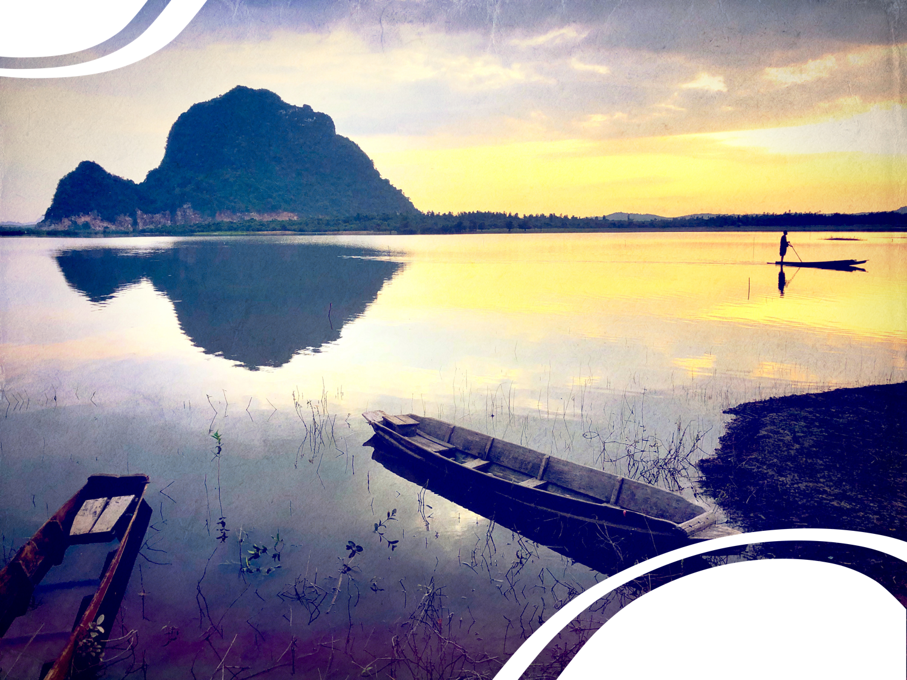
Human right to water within the broader context of water governance
Photo by Diana Suhardiman, IWMI-SEA
Incorporate the notion of representation and accountability
Unpack key factors that contribute to and/or hinder meaningful participation and representation
Illustrate how they are interlinked with the regulatory aspect

Slide 3
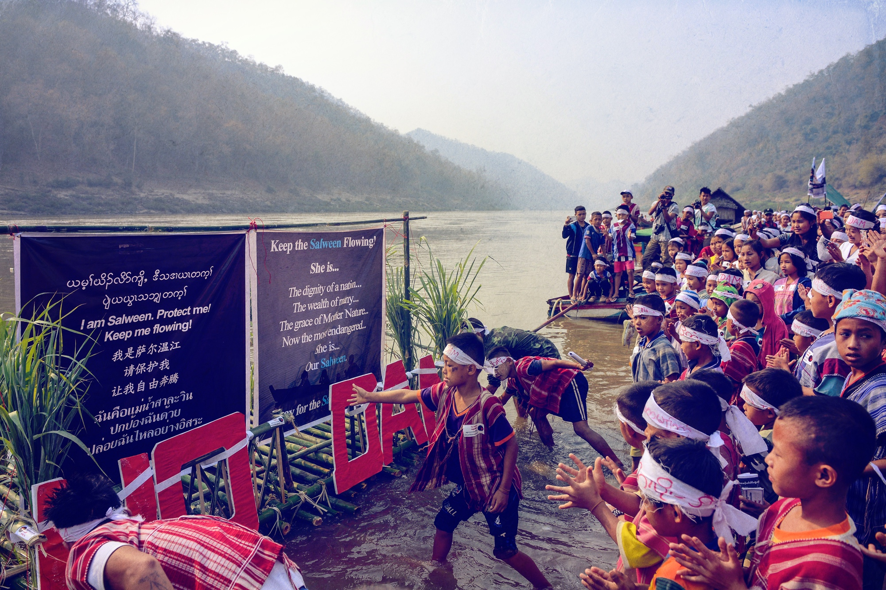
Photo by KESAN

Slide 4
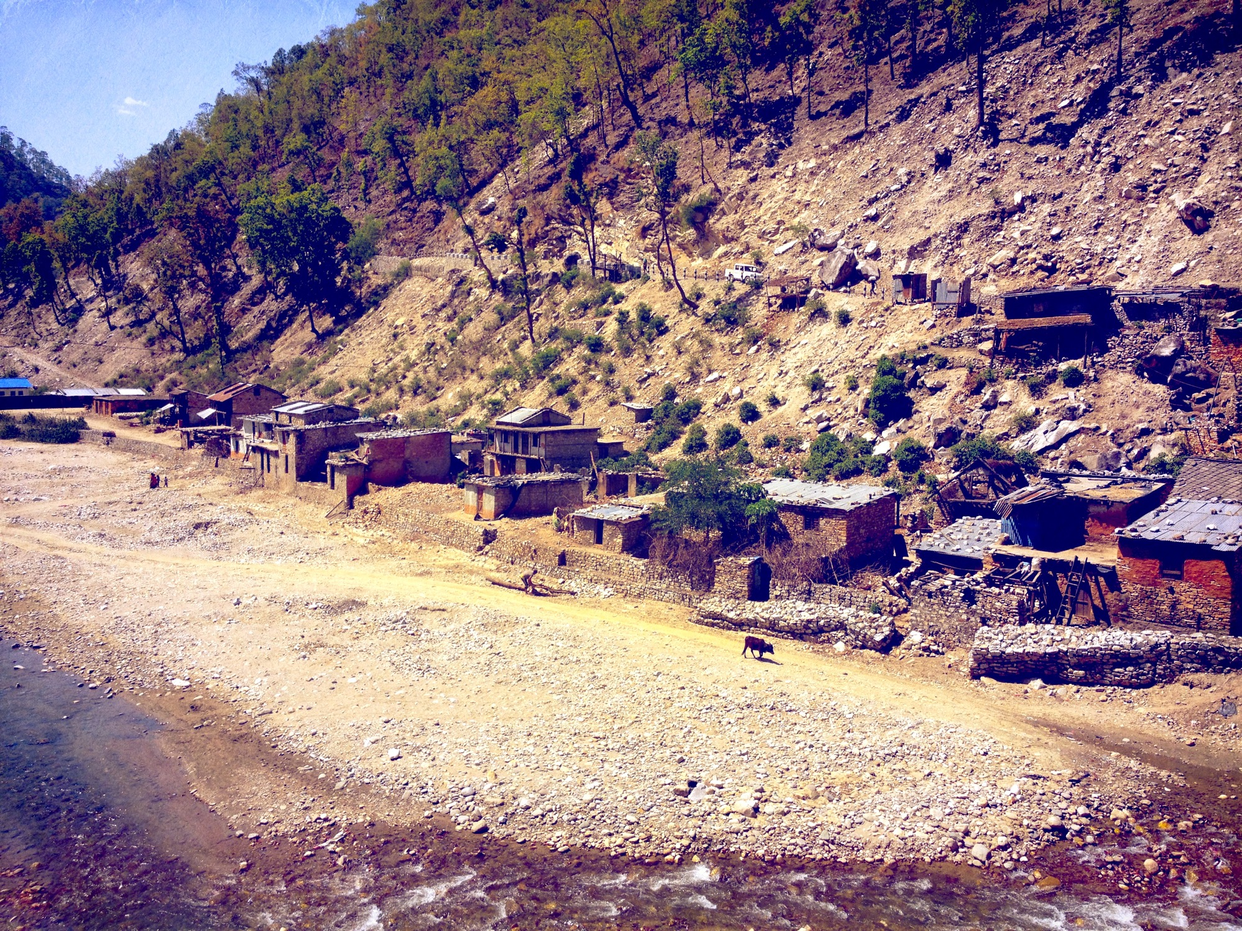
Photo by Diana Suhardiman, IWMI-SEA

Slide 5
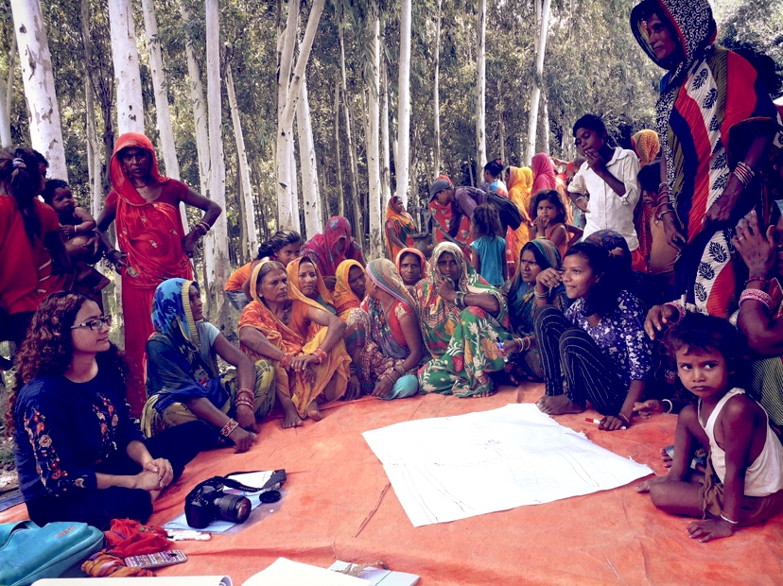
Photo by Manita Raut, IWMI-Nepal

Slide 6
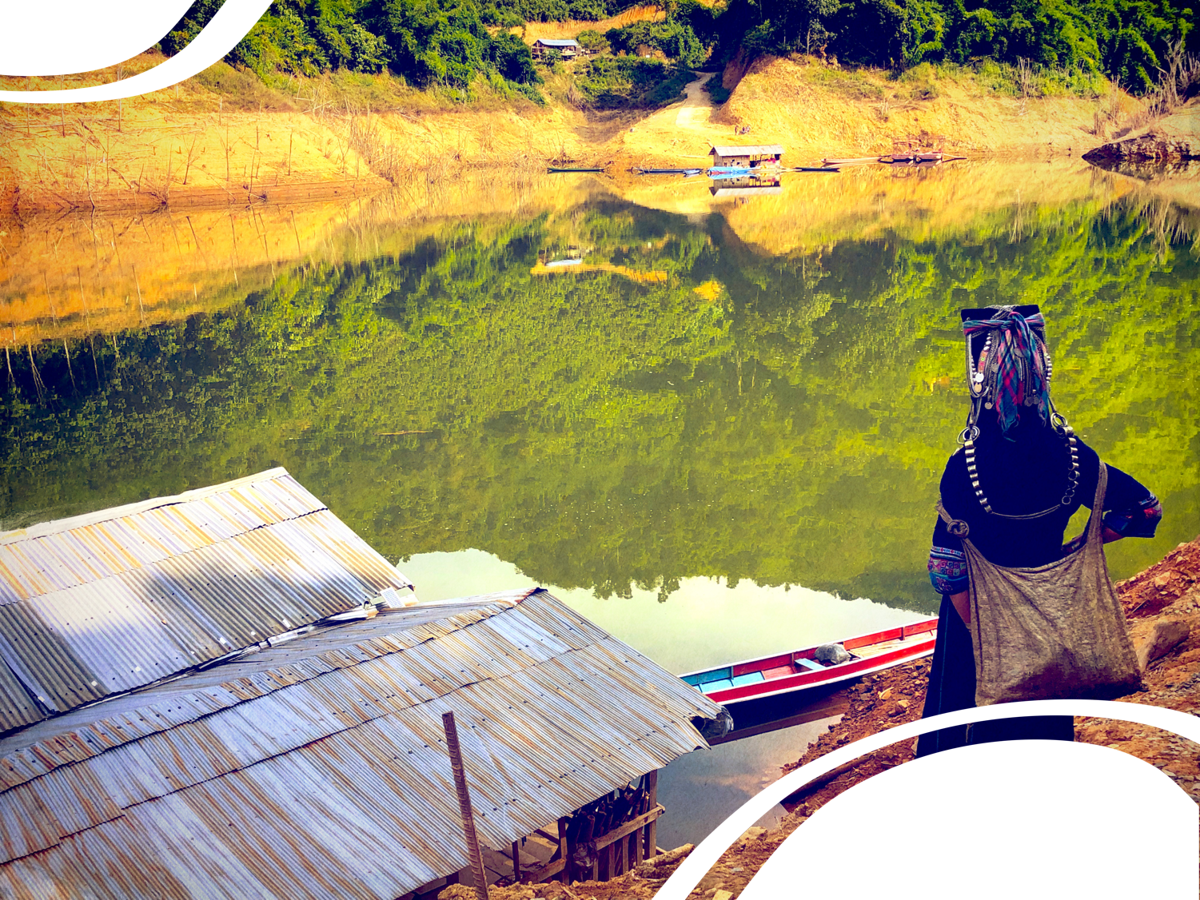
Key advantages to link water governance research with human rights to water
Photo by Diana Suhardiman, IWMI-SEA
Focus on participation, representation and accountability towards more equal and inclusive development
Identify key challenges in water governance decision making set up and processes
Understand power relations (re)shaping these challenges
Create equal playing fields for powerful and less powerful groups including the most marginalized

Slide 7
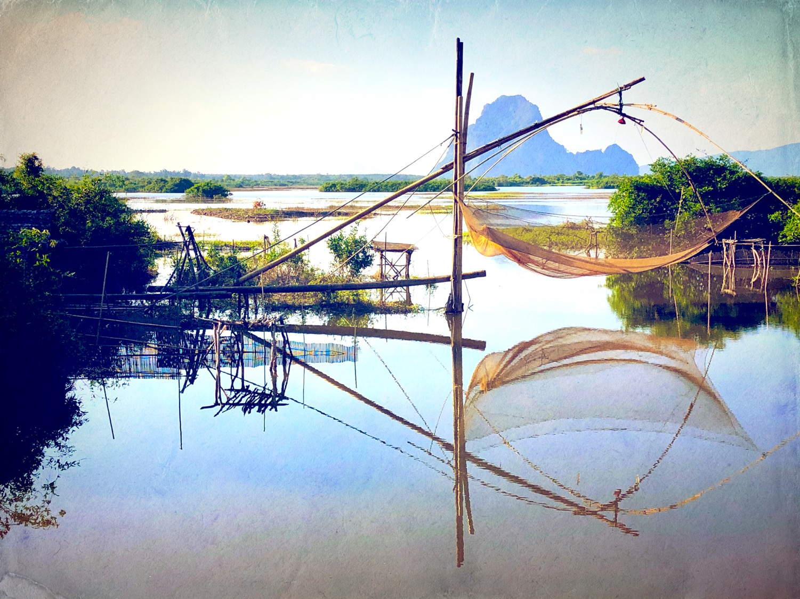
Thank you
d.suhardiman@cgiar.org
Photo by Diana Suhardiman, IWMI-SEA

